Slide 1
Assignment 3 Custom UI Component
Assignment 3
Student Number: A…
Student Name: …

Slide 2
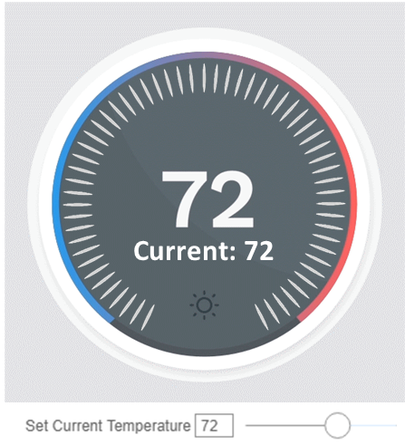
View Tree
MainPanel
DisplayFace
TextDisplay
RadialSlider
DisplayBackground
TargetTemperature
CurrentTemperature

Slide 3
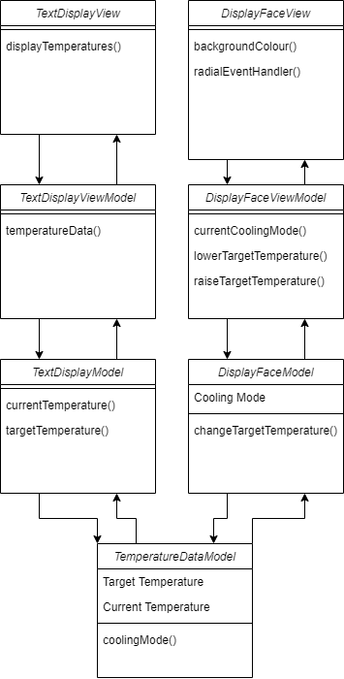
Class Diagrams

Slide 4
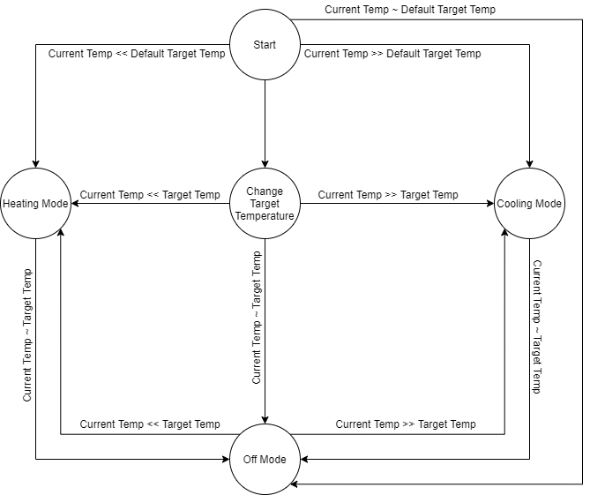
Statechart http://draw.io/...

Slide 5
Define any Convenience Functions

Slide 6
Details of Radial Slider

Slide 7
Bonus: Overriding Mouse Wheel Scroll

Slide 8
Justifications for Architecture and Technology Choices

Slide 9
Justification: Rendering Challenges and Approach

Slide 10
README: project files organization
Folder/
Folder2/
…
File1
File2
…
Provide more details describing purpose of each file.

